Slide 1
Social Media Sentiment Analysis of Russia’s War in Ukraine
Group 10
Andrew Du, Haowen Li, Siyuan Wang, Steven Xie, Yunhao Zheng, ​Yunjie Xu, Zhijian Zhu
Fall 2022

Slide 2
Agenda
Sentiment classification
Sentiment Modeling
Model Application on datasets related to Russia’s war in Ukraine
Factors and topics identification
Recommendations to Ukraine government and international NGOs

Slide 3
Sentiment Modeling

Slide 4
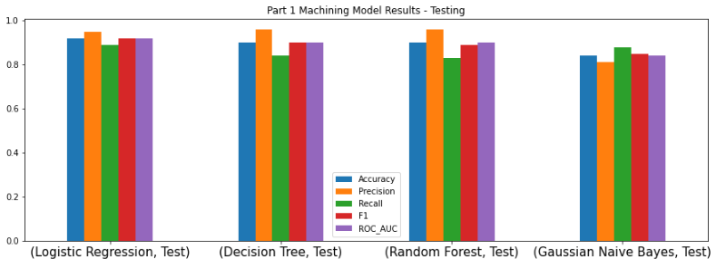
Sentiment Modeling
Dataset used for training
250,420 Prepared Tweets with Binary Labels
Model selection
Logistic Regression - best accuracy & least computational cost
Model accuracy
92% accuracy on both training and testing set

Slide 5
Model Application on
Datasets related to Russia’s war in Ukraine

Slide 6
Model Application
Datasets related to Russia’s war in Ukraine
18,521 Tweets
2,410 Reddit Posts
Apply the Logistic Regression Model

Slide 7
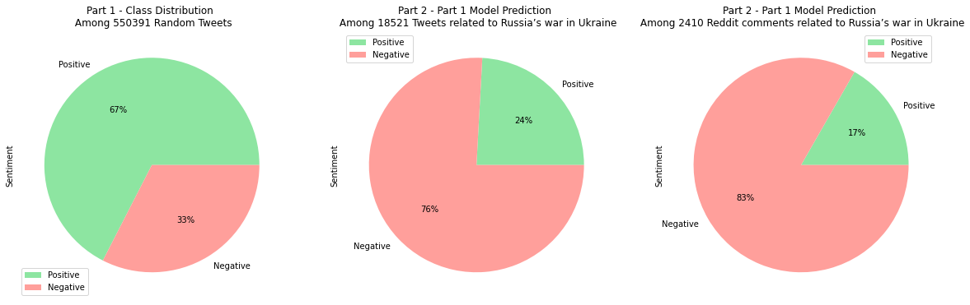
Social Media Sentiment Classification

Slide 8
Factors & Topics Identification
Using LDA Model

Slide 9
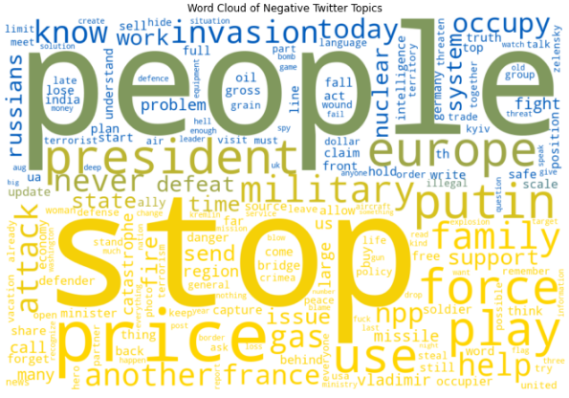
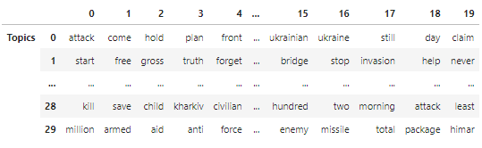
Latent Dirichlet Allocation (LDA) Model
Twitter & Reddit
30 Topics per Sentiment
20 Words per Topic
Extracted Topics from the Negative Tweets

Slide 10
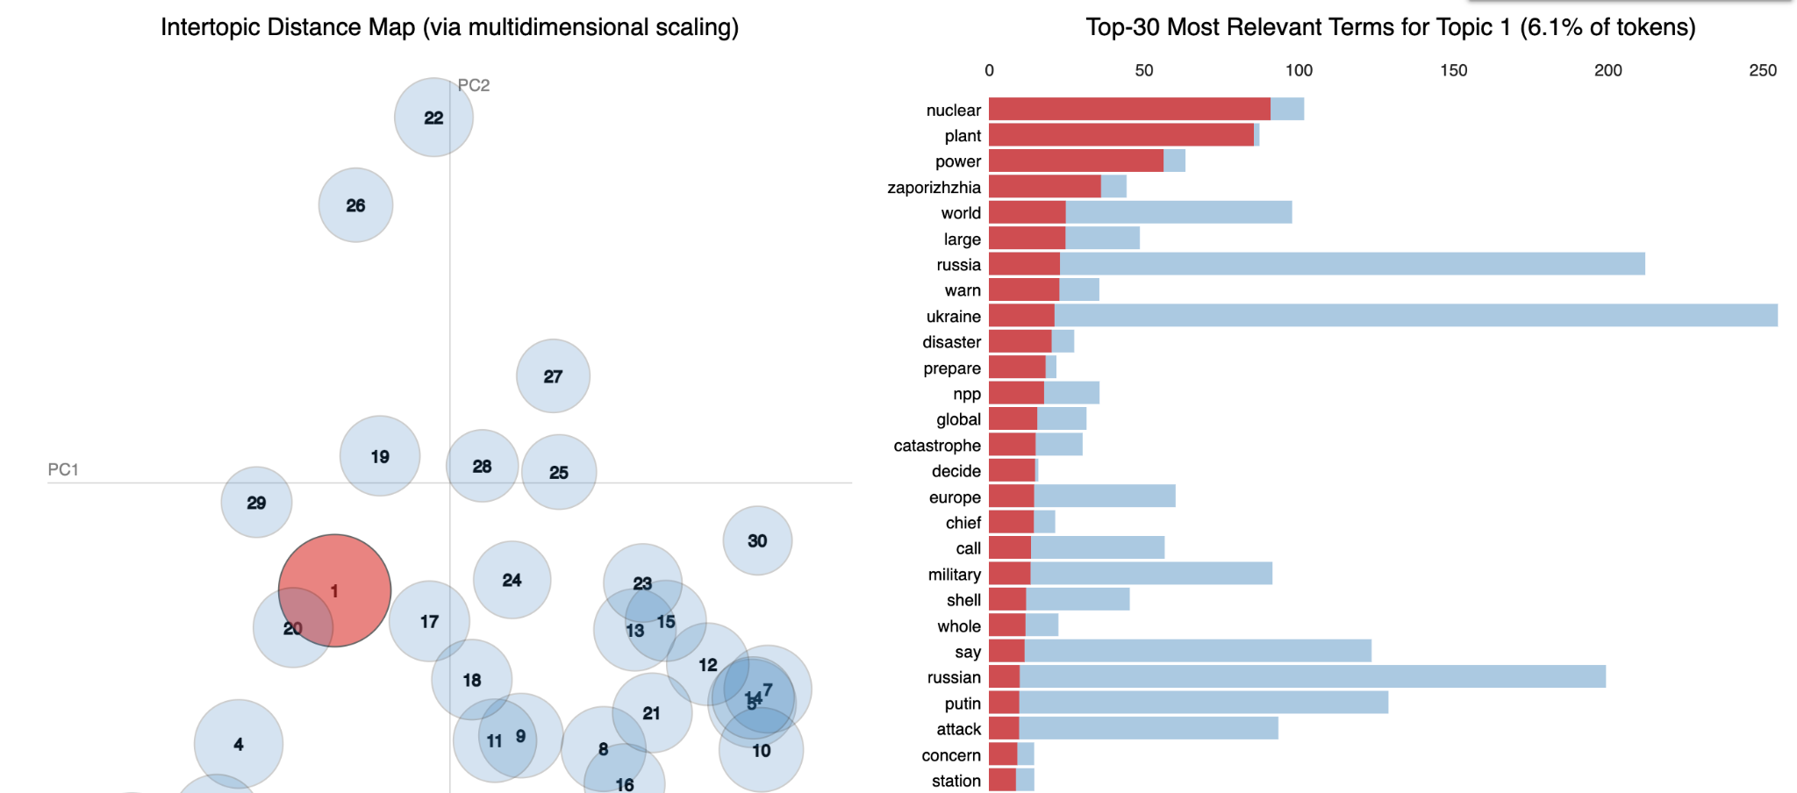
Russia Controls the Zaporizhzhia Nuclear Plant
Topics on Twitter and Reddit

Slide 11
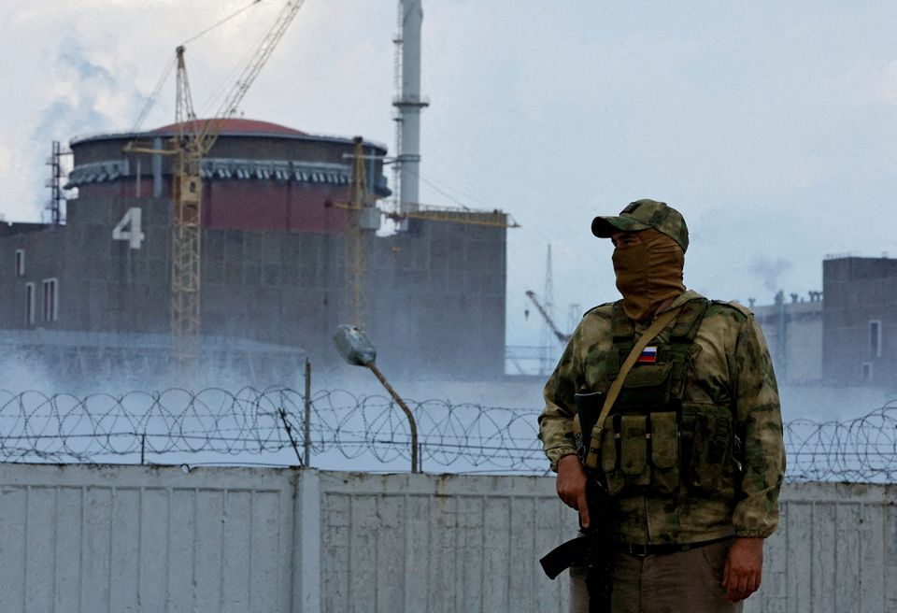
Russia Controls the Zaporizhzhia Nuclear Plant
Influence
Nuclear Plant in the wrong hands
Tremendous threat to Europe
Russia ready to abandon Zaporizhzhya plant in exchange for transit of oil and gas through Ukraine

Slide 12
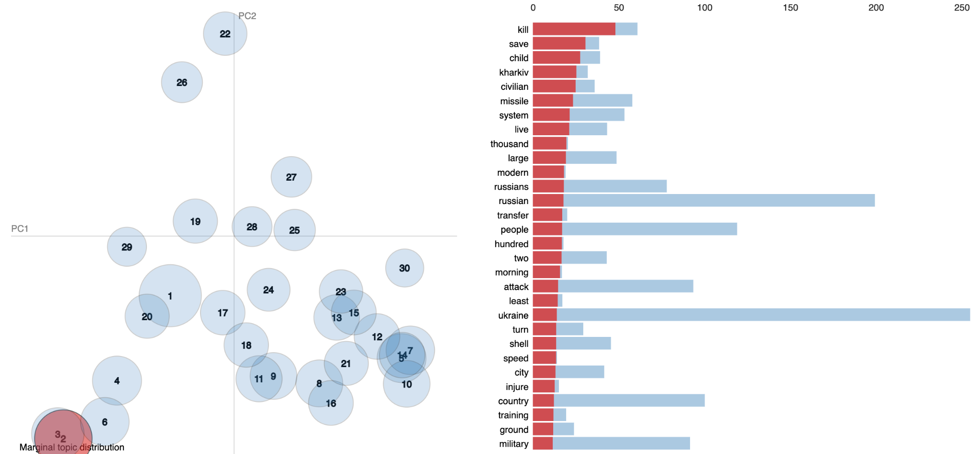
Russia Launches Missiles at Residential Areas
Topics on Twitter and Reddit

Slide 13
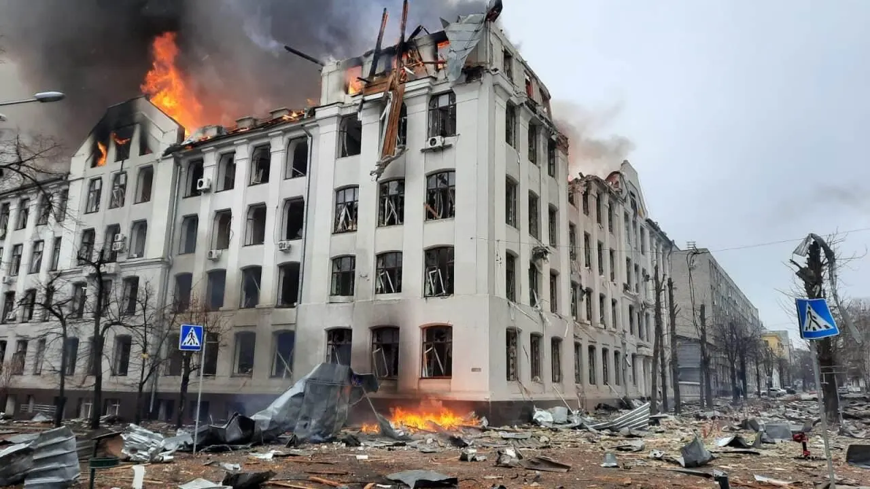
Russia Launches Missiles at Residential Areas
Influence
Deadly Russian missile strikes hit Kharkiv
Death toll rises to 31 In destroyed apartment block
Civilians were killed

Slide 14
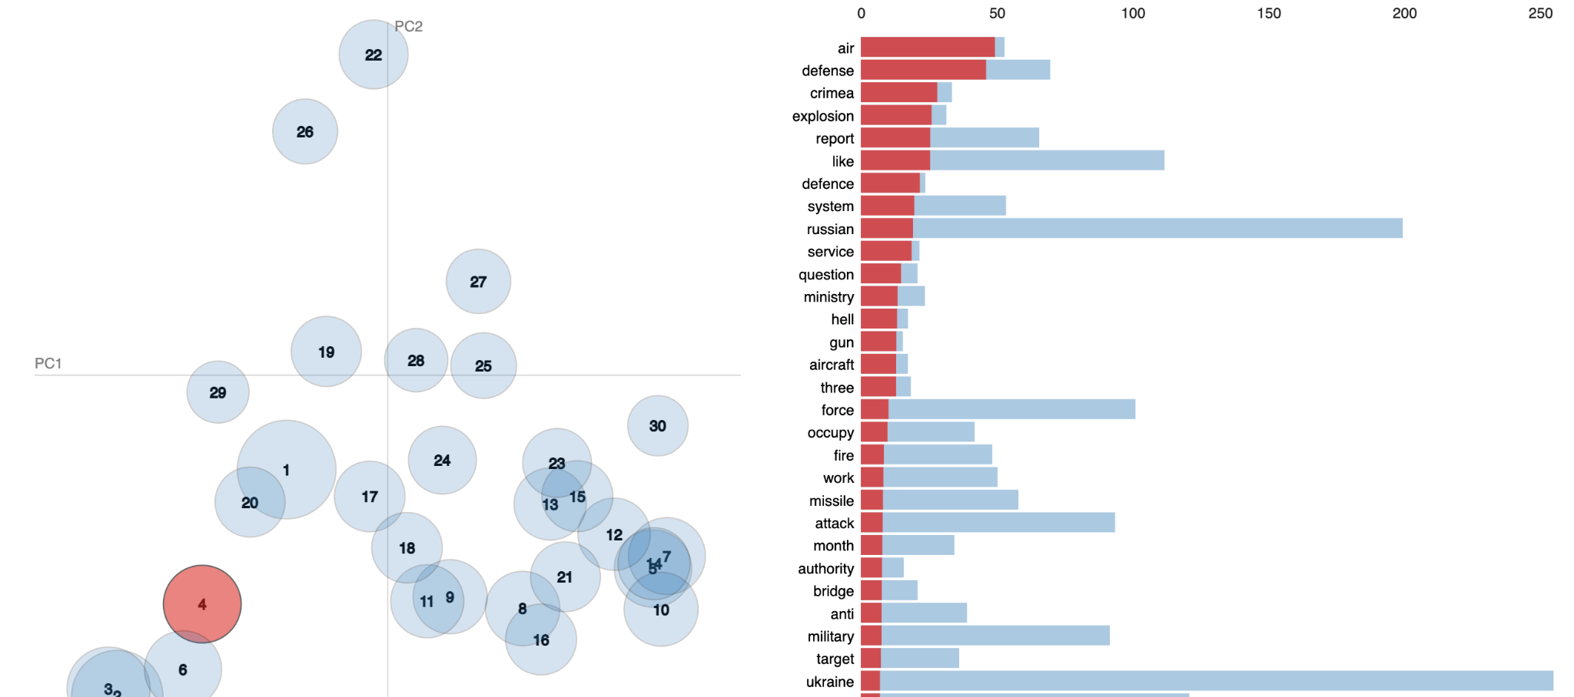
Crimean Bridge Explosion
Topic on Twitter

Slide 15
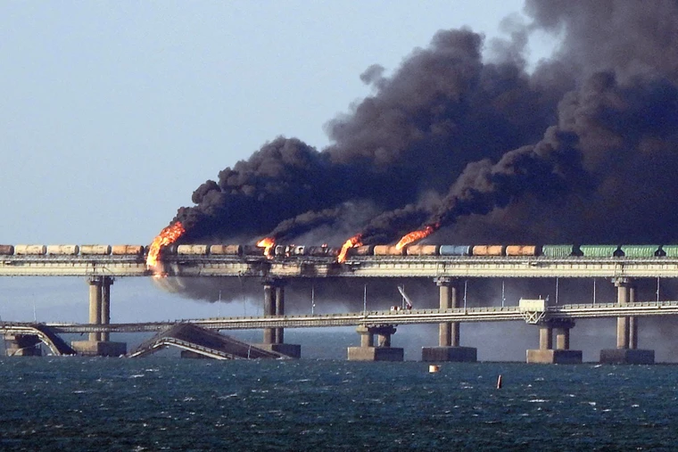
Crimean Bridge Explosion
Influence
Zelensky said that the Ukrainian government "did not order" it
Russia has been accusing Ukraine of the explosion
Harms Ukraine’s international presence and image

Slide 16
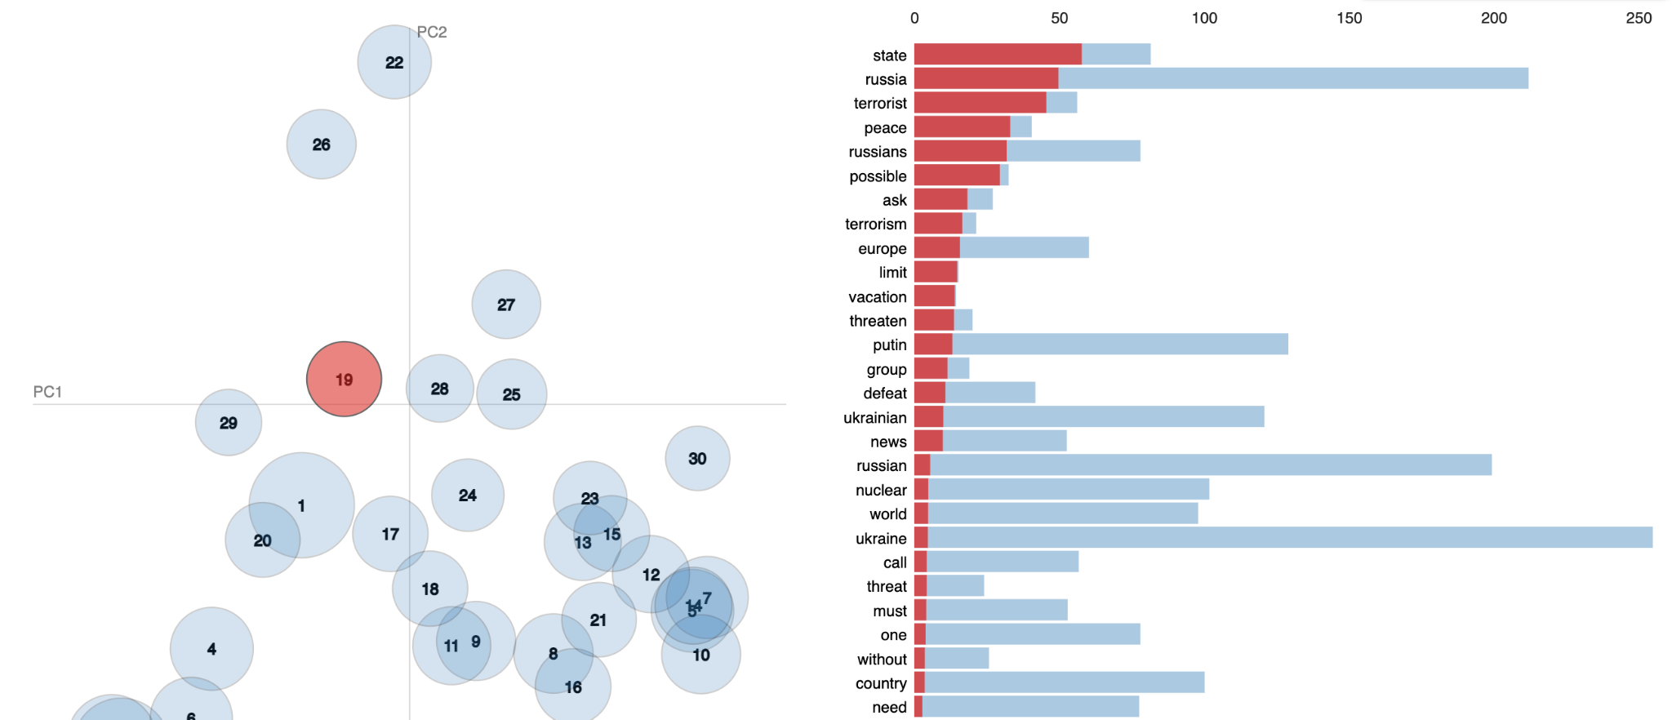
Putin’s Regime
Topic on Twitter

Slide 17
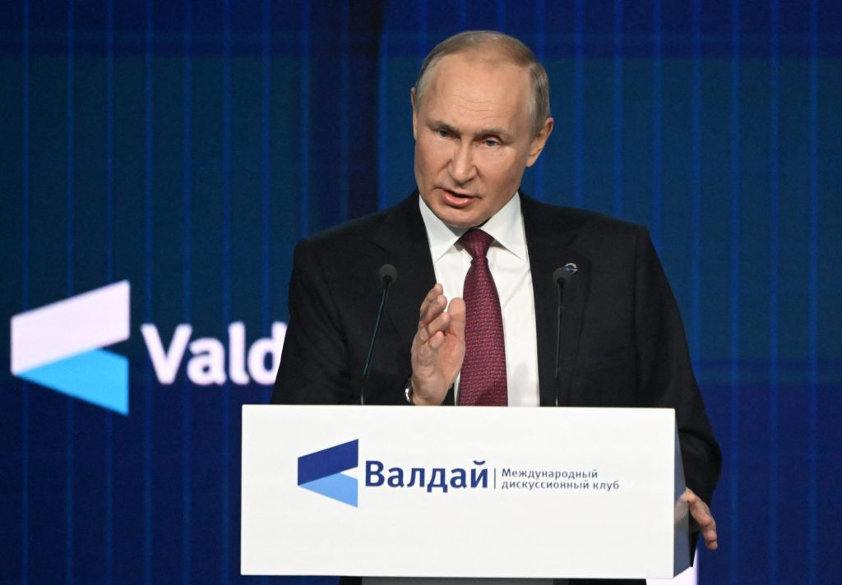
Putin’s Regime
Influence
Nazis & Satanists & Terrorism
Humanity is being trampled
Putin was running out of excuses for his imperial war on NATO
War crime

Slide 18
Recommendations to
Ukrainian government & International NGOs

Slide 19
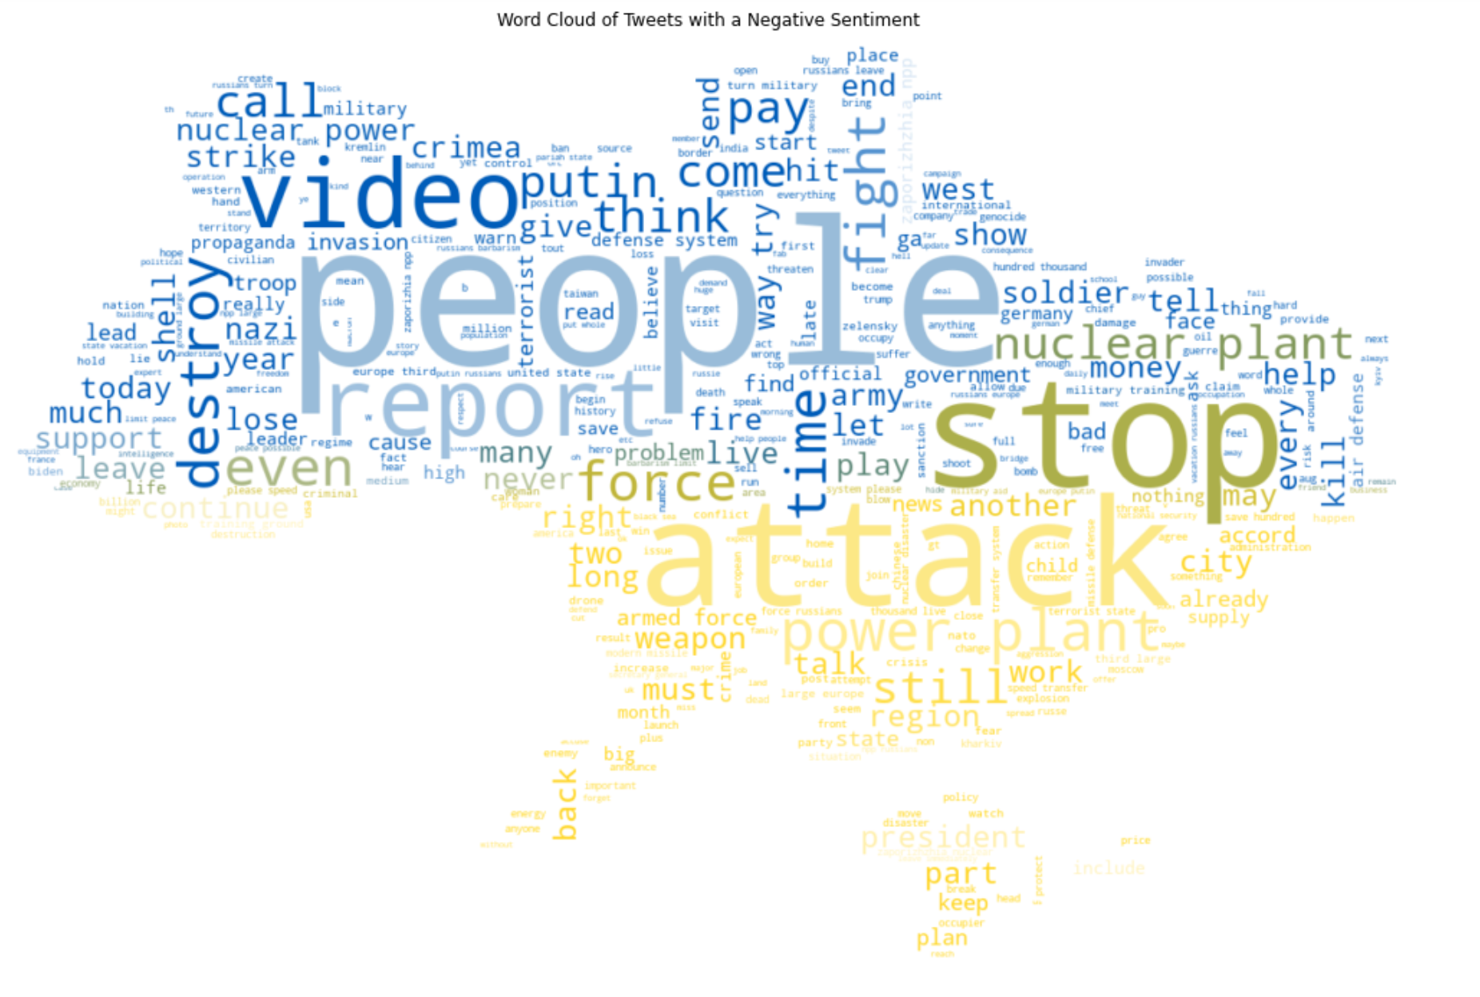
Recommendations
Let Russians know the truth about the war
Documentary videos
Infiltrate the Russian social media
Unveil the truth of the war

Slide 20
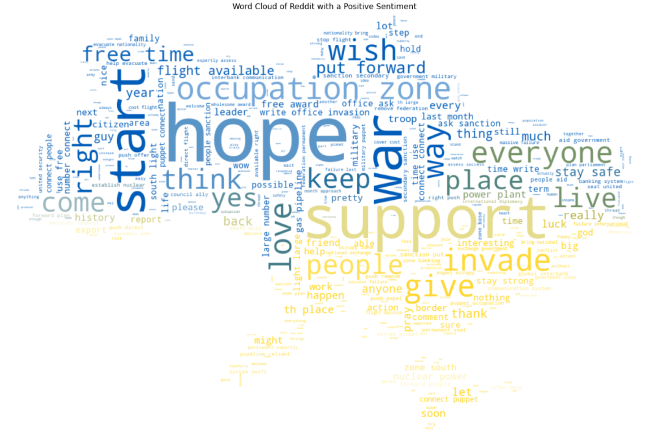
Recommendations
Keep Hope and Provide Support
Urge more countries to join the fight for peace and justice
Collect mental and monetary support from all over the world
Support the post-conflict reconstruction in Ukraine

Slide 21
Thank You!

